Slide 1


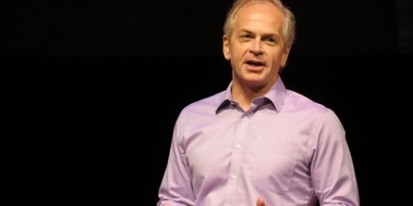


Cryogenic DRAM based Memory System for Scalable Quantum Computers: A Feasibility study
MEMSYS-2017
Swamit Tannu
Doug Carmean
Moinuddin Qureshi
Notes:
Thanks sally for giving us great insights into cool memory,
Good Morning ! I am swamit, thank you for coming to my talk. I am a PhD student at Georgia Tech and this work was done in collaboration with Doug Carmean at Microsoft Research, and My advisor Moinuddin Qureshi at Georgia Tech

Slide 2
Outline
Background: Quantum Computing
Why Cryogenic DRAM for Quantum Computers?
Experimental Setup & Challenges
Observations
Conclusion
Notes:
Today, I will talk about why quantum computers will require large capacity memories at cryogenic temperature, and can I will describe how did we charchterize DRAM at cryogenic temperature as a potential memory technology for quantum computers

Slide 3
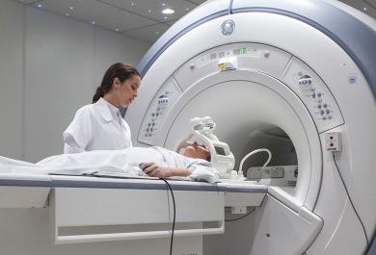
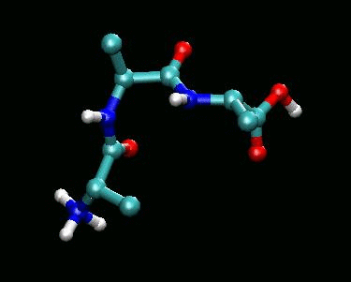
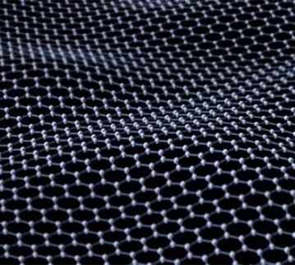
Why Quantum Computers?
Billion Years
Classical Computer
Molecule and Material Simulations
Execution Time
Quantum computers provide large speedup for problems in material science, machine learning, and medicine
Days
Quantum
Computer
Problem Size
Quantum Computers enable solutions to important problems
Notes:
Why build quantum computers?
- Can solve fundamentally hard problems material science, machine learning, and medicine
- Provide exponential speedups for problems which are currently unsolvable on conventional computers
Segway- Quantum algorithms utilize properties of quantum bits to achieve exponential speedup

Slide 4
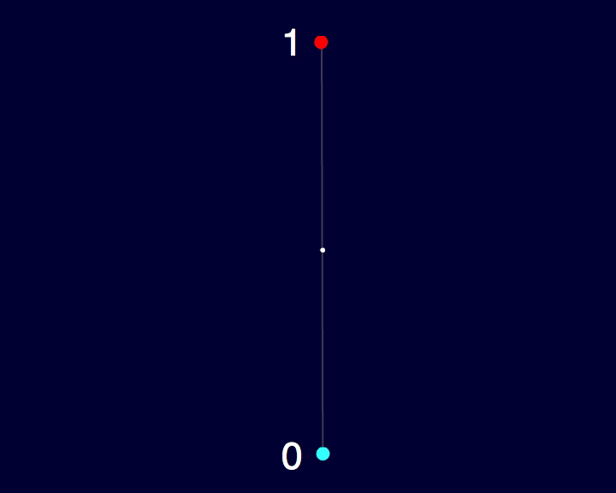
Qubits: Background
State of a Classical Bit
→ 1 or 0 two points on sphere
State of a Quantum Bit
Any point on the sphere
Quantum Bit
Classical Bit
Quantum computer use quantum bits (qubits) to encode the information
Notes:
The conventional computers use bits which has binary value. If we imagine a sphere a value of a single bit can describe two points on the sphere lets say top most point and bottom most point. However, with a single qubit we can describe all the points on sphere. So the quantum computers have ability to process enormeous amounts of information than the conventional computer don’t. So quantum computer solve problems by manipulating the state of the qubit.
Segway– How do we manipulate the state of the qubit

Slide 5

Organization of Quantum Computer
Control Processor
Qubits
Quantum Computer
Control Processor instructions to qubits, to manipulate qubit state
Notes:
To manipulate the state of qubits we need a conventional computer – ‘control processor’. The control processor is an interface between qubits and the control processor.
Seems like straight forward design, so what's stopping us from building large scale quantum computer– qubits are fundamentally fickle, they can lose their state by interacting with environment
but even at small temperature

Slide 6
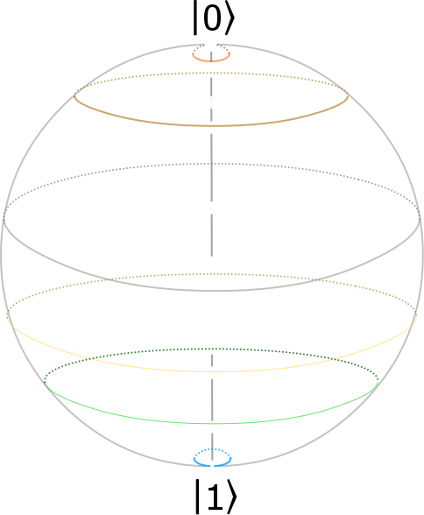
Qubits are fickle
No quantization → small change in state lead to errors
Room temperature → too noisy to operate
1
0
Classical Bit
Quantum Bit
Qubits are fickle, kept at extremely low temperature (~20mK)
Notes:
To manipulate the state of qubits we need a conventional computer – ‘control processor’. The control processor is an interface between qubits and the control processor.
Seems like straight forward design, so what's stopping us from building large scale quantum computer– qubits are fundamentally fickle, they can lose their state by interacting with environment
but even at small temperature

Slide 7
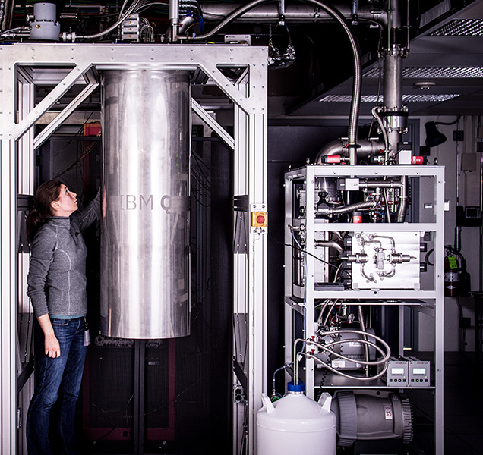

Todays Quantum Computer
Dilution Refrigerator
5 Qubit Chip (IBM)
Qubits
5 Qubit Chip (IBM)
20mK
Notes:
1 min
Boarder Qubit, and Control

Slide 8
Cryogenic Control Processor
Control Processor
4K
Control Processor
300K
Metal Wires
→ Thermal Leakage
Superconducting wires
→ Low Leakage
Qubits
20mK
20mK
Qubits
Cryogenic Control Processor is essential for scalable Quantum Computer
(Ref: Cryogenic Control Architecture for Large-Scale Quantum Computing by Hornibrook et. al)

Slide 9
Memory for Quantum Computers
Program Memory + Data Memory → Stores Quantum Executable , Data , ECC-frames (~10s GB)
Memory must be kept at cryogenic temperature to avoid large thermal gradient
Josephson Junction technology works at 4K
→ Limited memory density (only few Mb)
Program Memory
Data Memory
Memory
Control Processor
Qubits
Quantum Computer
Quantum computers require substantial memory capacity at cryo temperature
Notes:
Monologue:

Slide 10
Does commodity DRAM work at cryogenic temperatures ?
Goal: To characterize DRAM at cryogenic temperature to understand the functionality and error patterns
Notes:
Skip THIS AND MOVE IT TO BACKUP

Slide 11
Why Memory Fails at Cryogenic Temperature?
Faults
Temperature
Carriers (e⁻)
Threshold Voltage
Minimum Operational Temperature (MOT) →
Minimum temperature for fault free operation
At low temperatures, carrier freezeout can cause increase in threshold voltage
→ worsens error rate
Notes:
Th Voltage intu
Chuck The graph

Slide 12
OUTLINE
Background- Quantum Computing
Why Cryogenic DRAM for Quantum Computers
Experimental Setup & Challenges
Observations
Conclusion
Notes:
Goal and Outline
Goal
Setup
Challenges
Obserbations

Slide 13
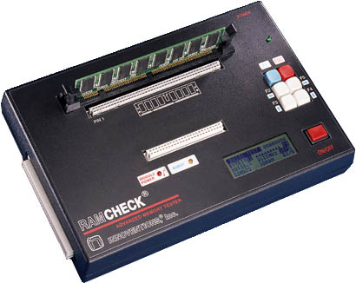
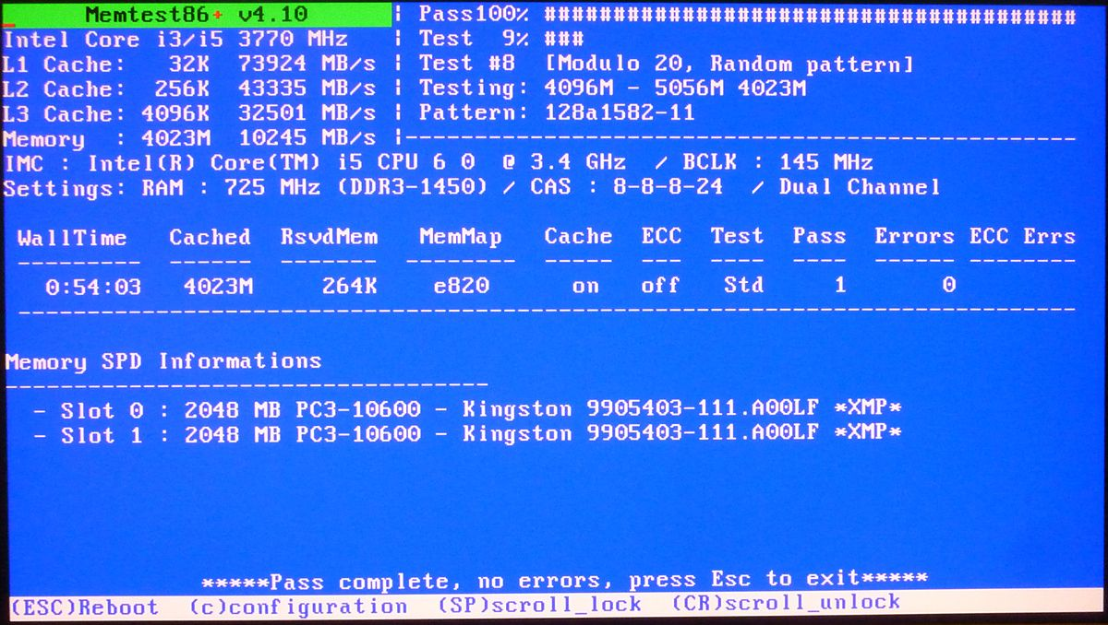
How to Test DRAM at Cryogenic Temperature?
Conventional memory testing → Memtest86 running on host, dedicated memory testers
Host machines or memory testers do not work at cryogenic temperatures
Need mechanism to reduce DIMM temperature without affecting tester

Slide 14
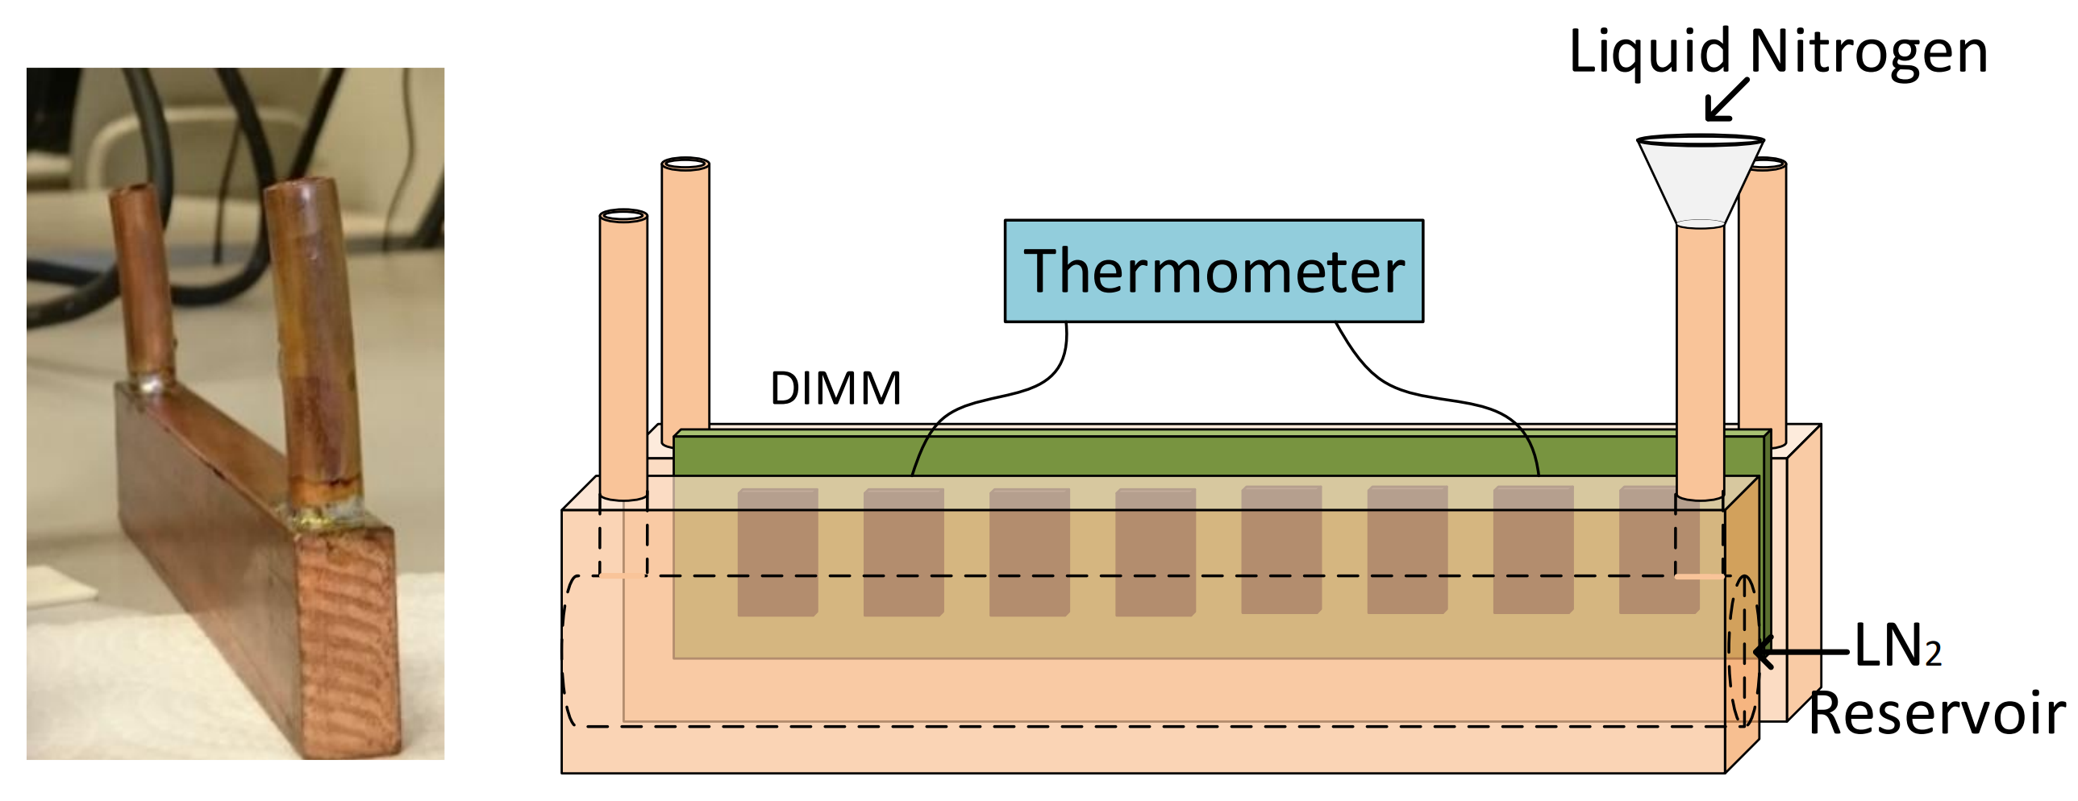
Isolated Cooling of DIMM
Need cryogenic coolant → Liquid Nitrogen (boils at 77K)
Need isolated cooling of DIMMs → Compact cryogenic heatsink
DIMM is sandwiched between two heatsinks and can be cooled down to 80K
Compact heatsink with Liquid Nitrogen provides isolated cooling of a DIMM

Slide 15
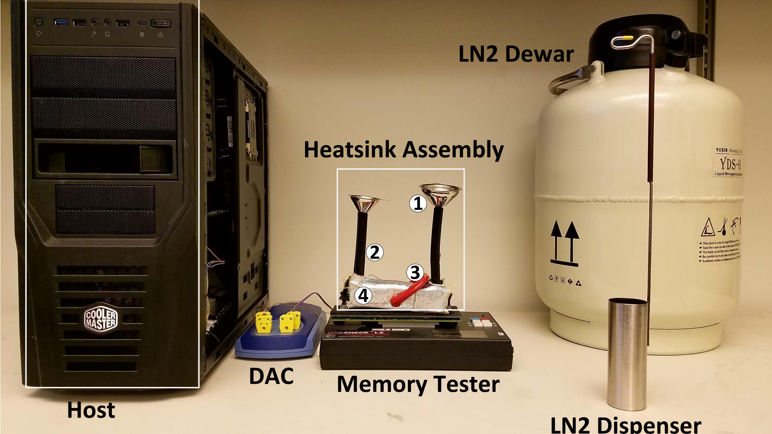
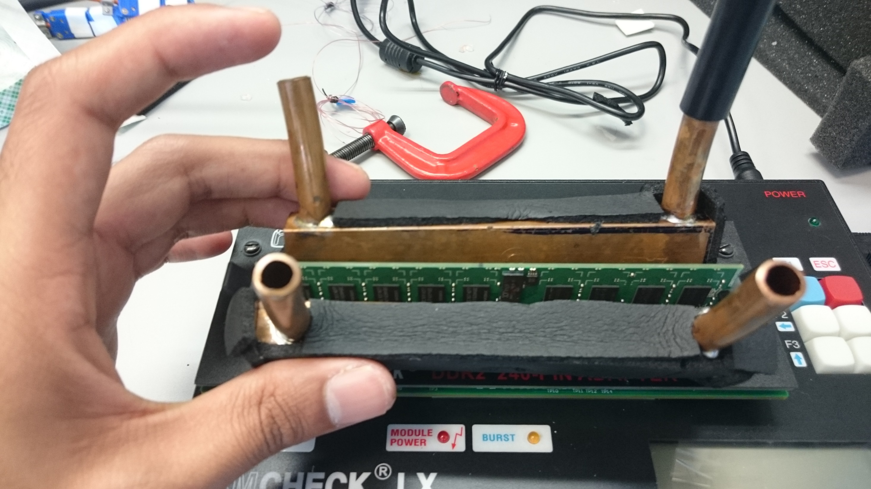

Slide 16

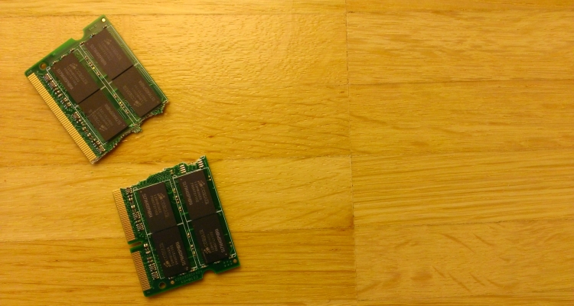
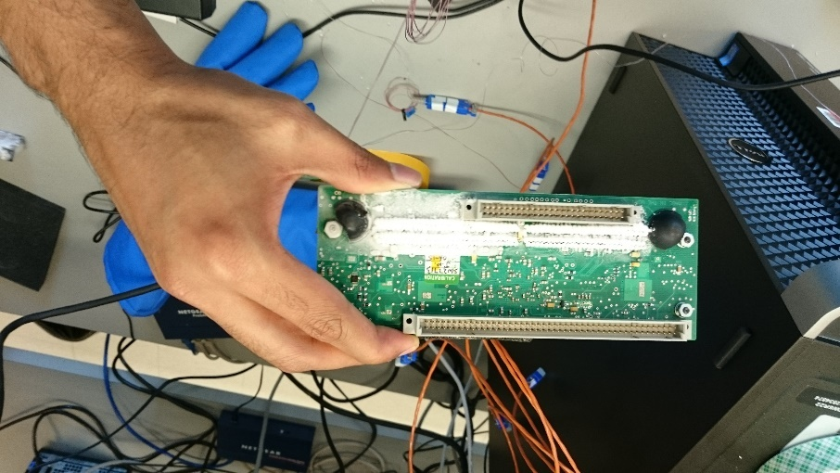
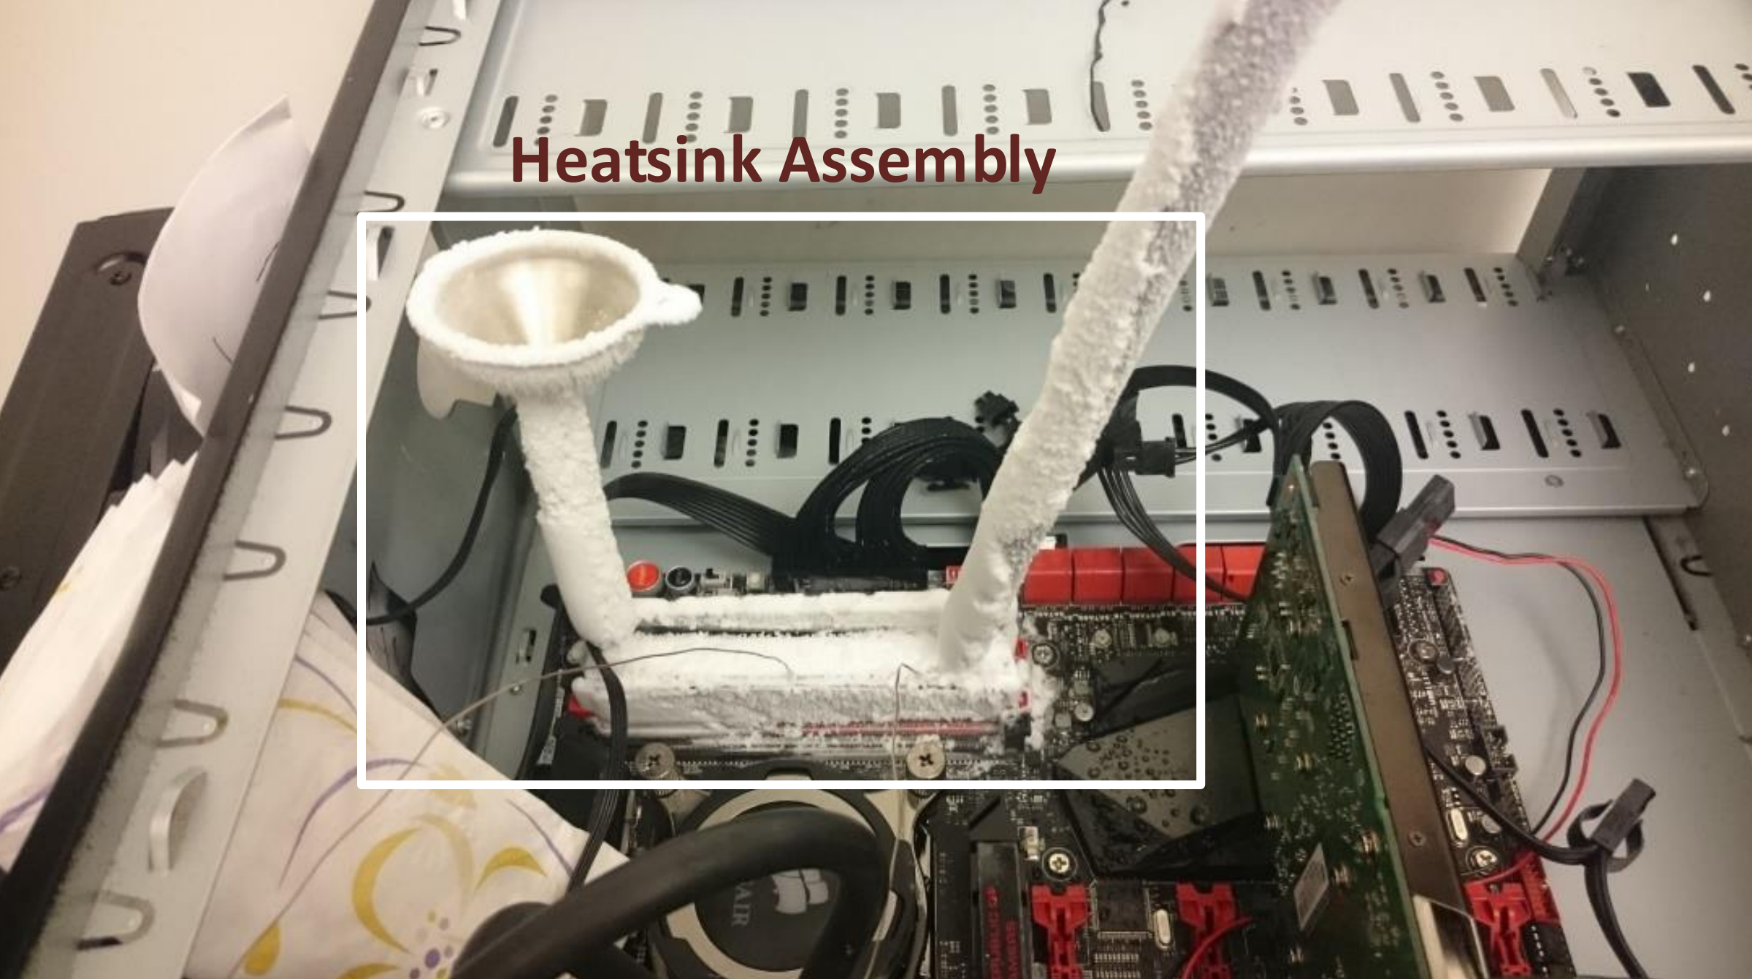
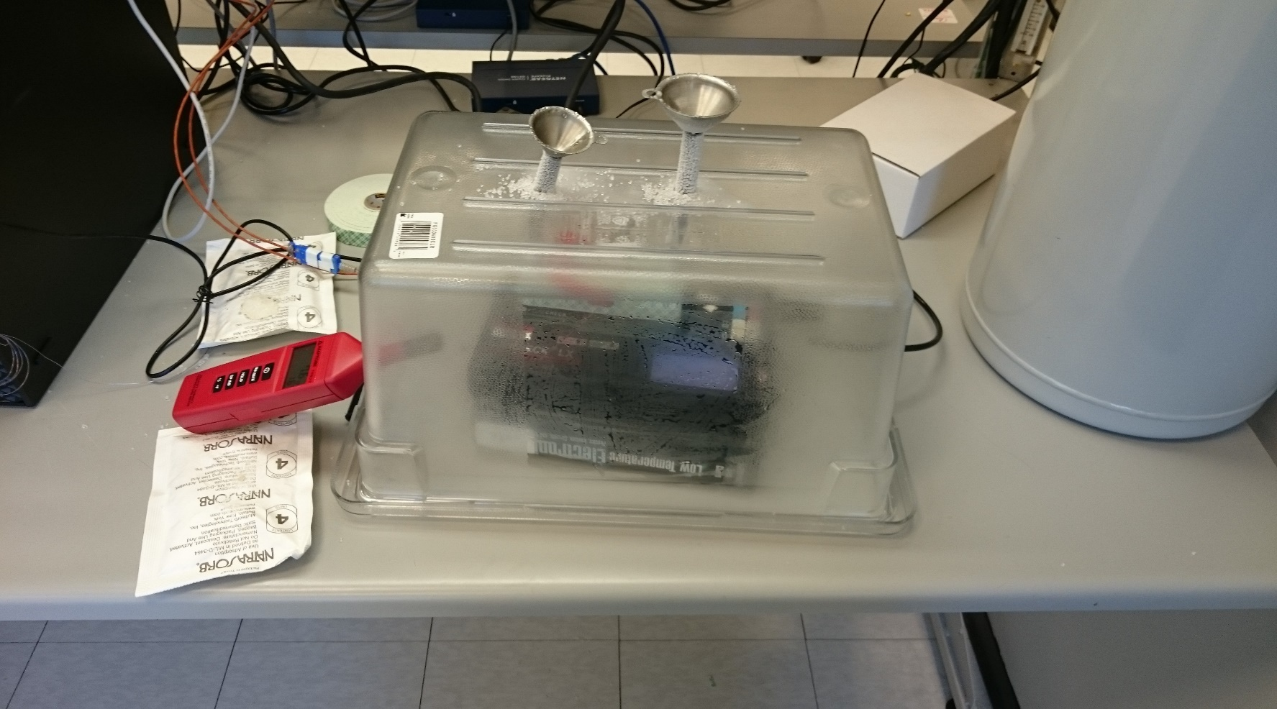
Challenges: Thermal Shock & Ice Condensation
THERMAL SHOCK
Condensation
Condensation
300K
Temperature (K)
80K
Time
Limit rate of cooling & use isolation chamber to reduce condensation
Notes:
Number the challenges in the cruo testing
Need picture for Thermal Shock – cracked DRAM
Avoid Overlapping animations

Slide 17

Experimental Methodology
Verify memory functionality by using march-tests
Fault → single bit fault in a burst
MOT → Minimum temperature at which no faults are observed
55
Number of DIMMS
Number of Chips
750
5
Number of Vendors
Notes:
Title

Slide 18
Outline
Background- Quantum Computing
Why Cryogenic DRAM for Quantum Computers
Experimental Setup & Challenges
Observations
-- At what temperature DIMM fails?
-- Chip failure rate
-- Chip capacity vs failure rate
-- Single bit vs Multibit faults
-- Transient vs permanent faults
Notes:
Goal and Outline
Goal
Setup
Challenges
Obserbations

Slide 19
Minimum Operational Temperature for DIMMs
DIMM Failure!
Minimum Operating
Temperature (K)
18% DIMMs are functional below 90K
Notes:
Title
Animation

Slide 20
Chip Failures
8%
92%
92% of chips worked at cryogenic conditions— Pick cryogenic tolerant chips

Slide 21
Min Operational Temperature Vs Chip Capacity
256 Mb
512
Mb
1
Gb
2
Gb
4
Gb
Minimum Operating
Temperature (K)
MOT increases with capacity; capacity of chip is correlated to technology node

Slide 22
Fault Granularity
Single bit errors → Uncorrelated faults
Linear codes (SECDED, BCH) are still effective
Single bit fault | 99.985%
Double bit fault | 0.015%
Uncorrelated faults → Conventional ECC can be effective for Cryo DRAM

Slide 23
Transient Vs Permanent Faults
Transient error → address fail once
Permanent error → address fail multiple times
Permanent faults → conventional sparing techniques can be used

Slide 24
Conclusion
Quantum computers need dense memory at low temperature
Does Commodity DRAM Work at cryogenic temperature?
Experiments show → most commodity DRAM chips work at 90K
Error patterns are amenable to existing fault tolerance techniques

Slide 25

Questions?
Want to know more about quantum computers?
Please visit my paper presentation at MICRO 2017 → In 2 weeks in Boston!
Notes:
Want to know more about quantum …
Thank you and I will be happy to take questions

